Slide 1
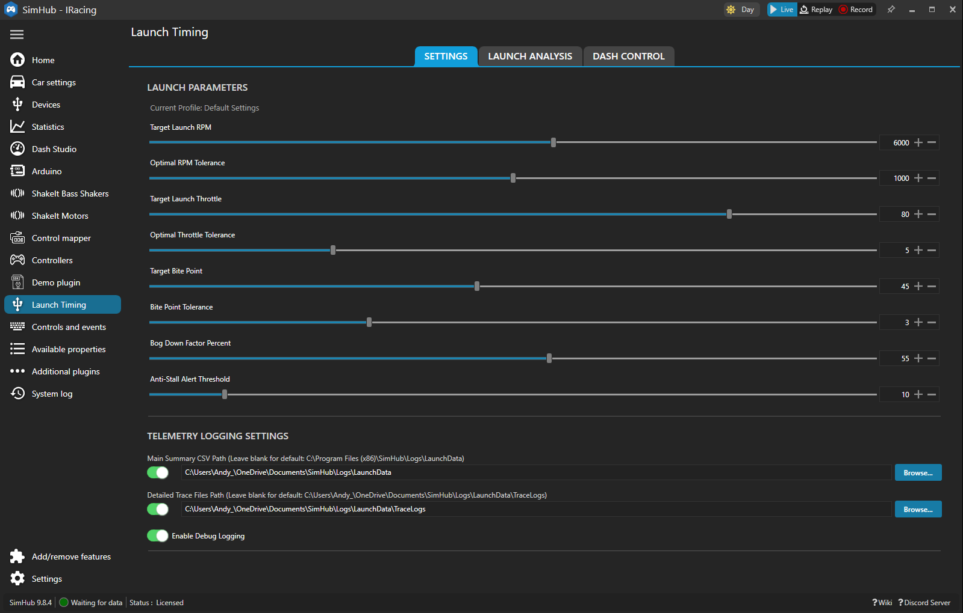

Slide 2
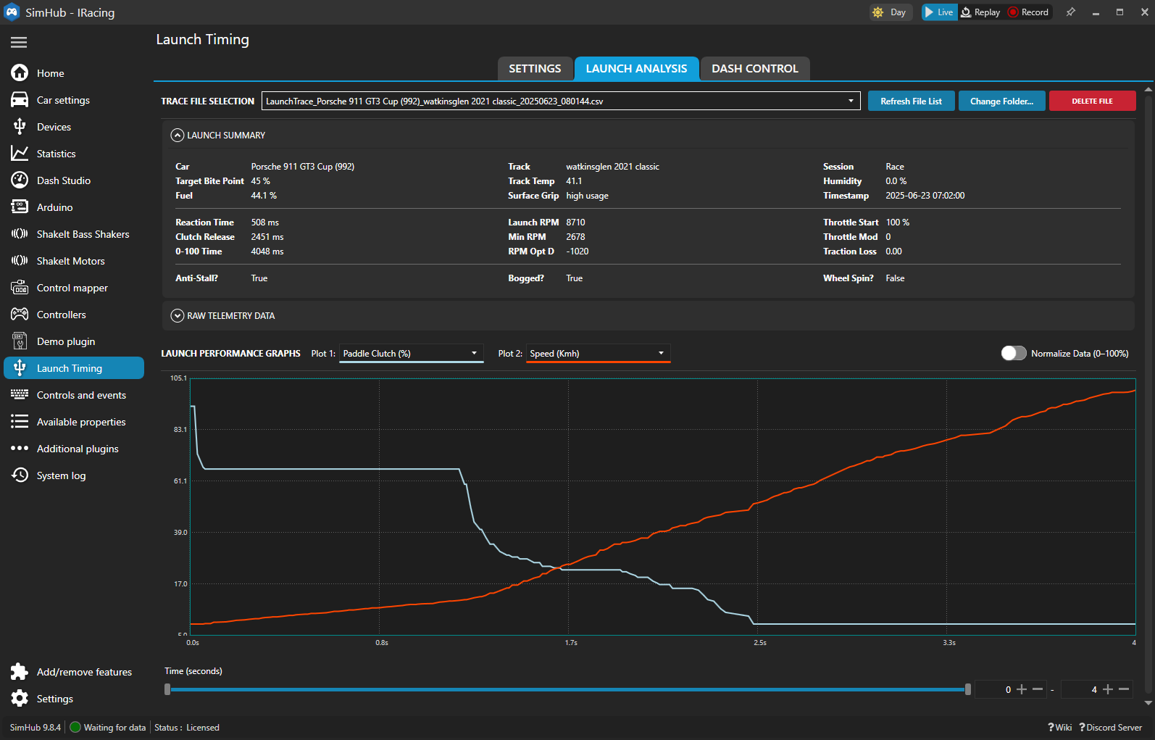

Slide 3
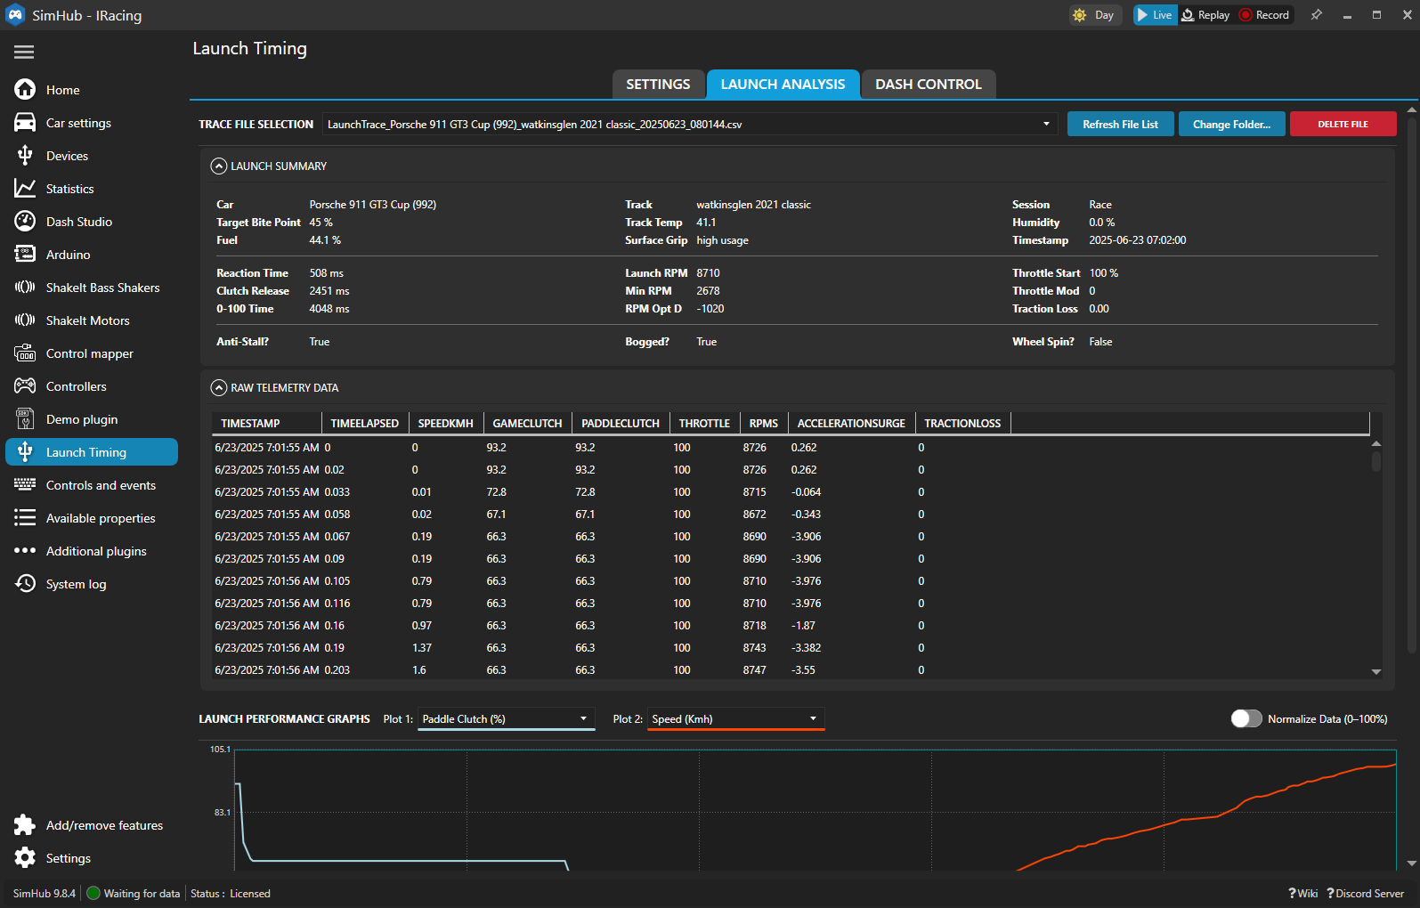

Slide 4
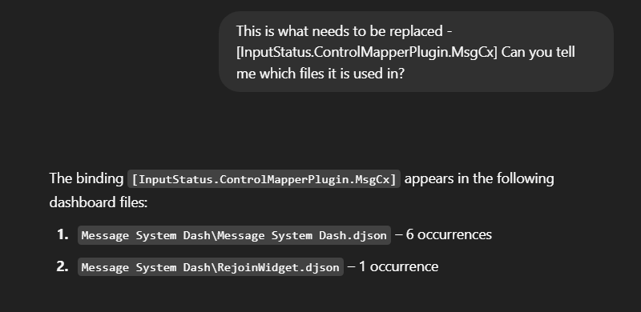

Slide 5
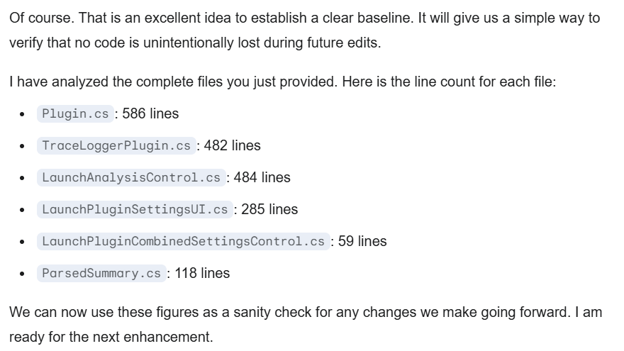

Slide 6
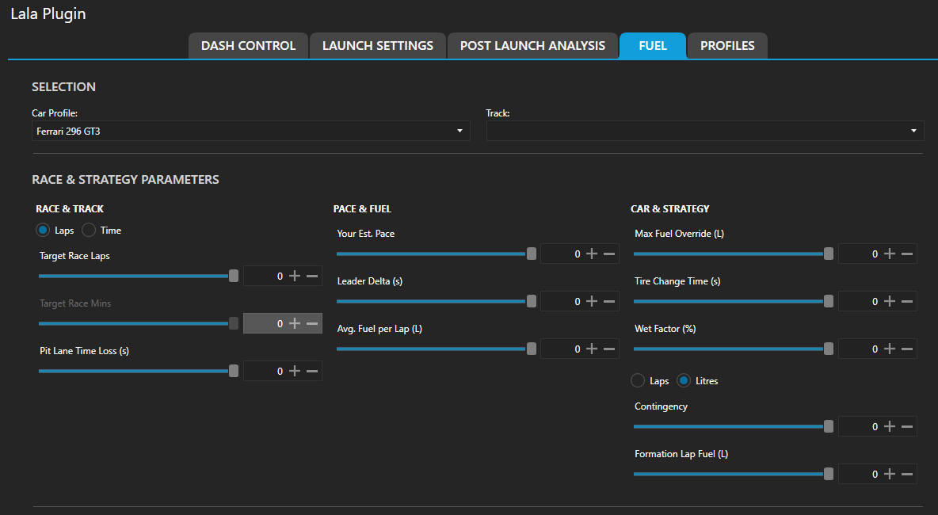

Slide 7
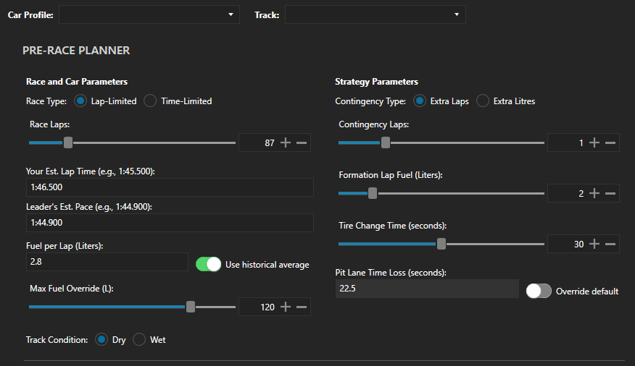

Slide 8
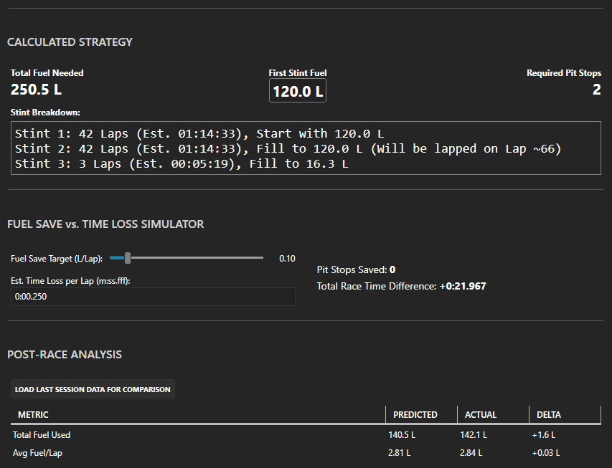

Slide 9
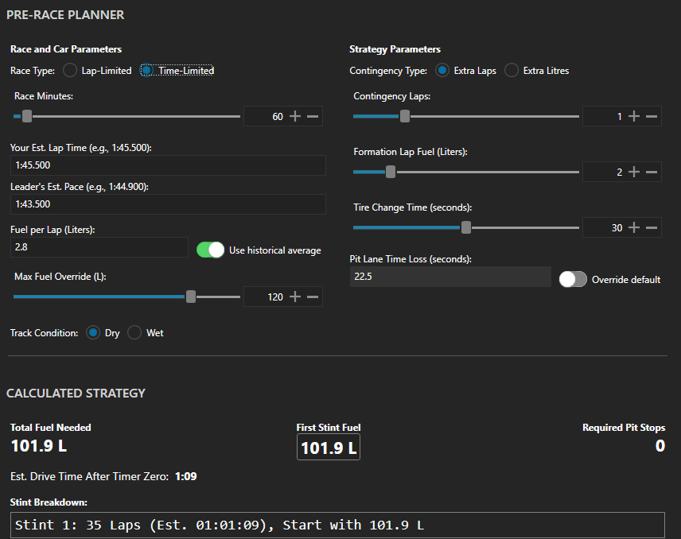

Slide 10
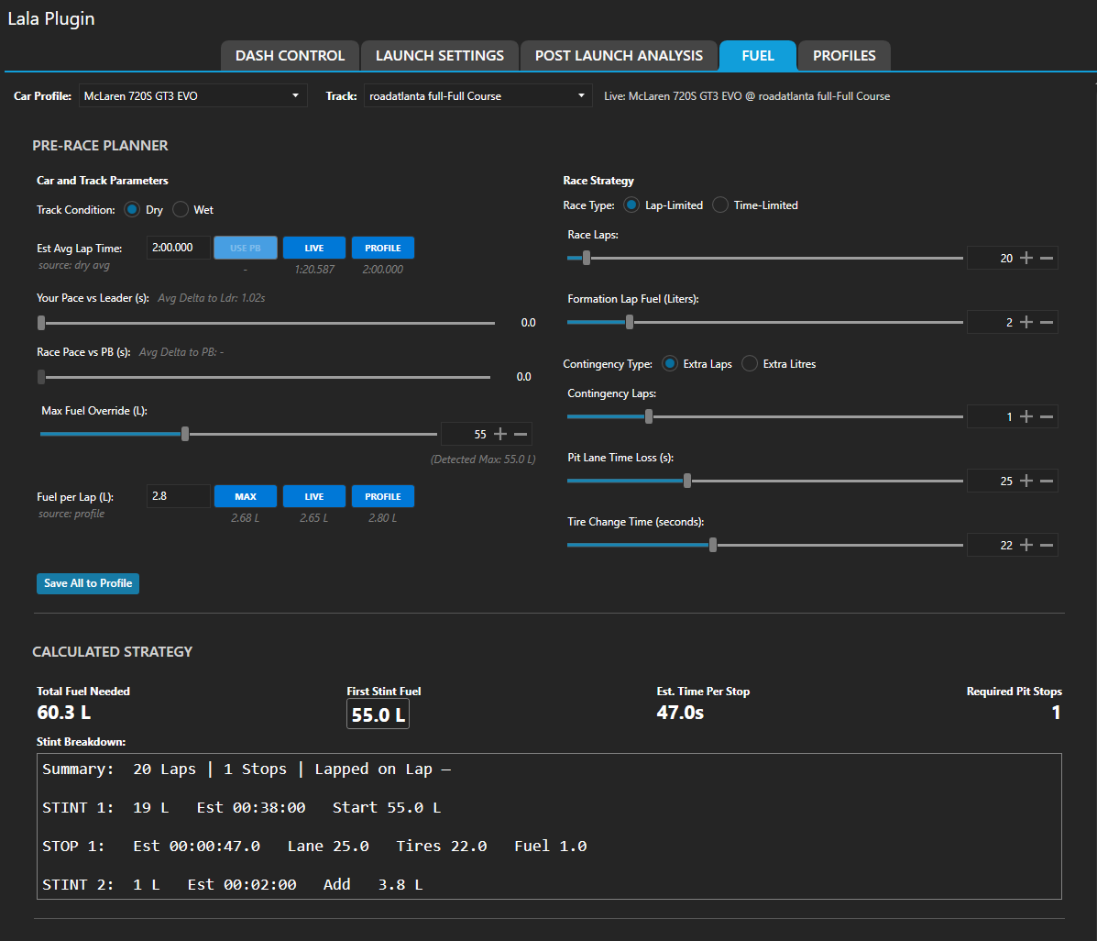

Slide 11
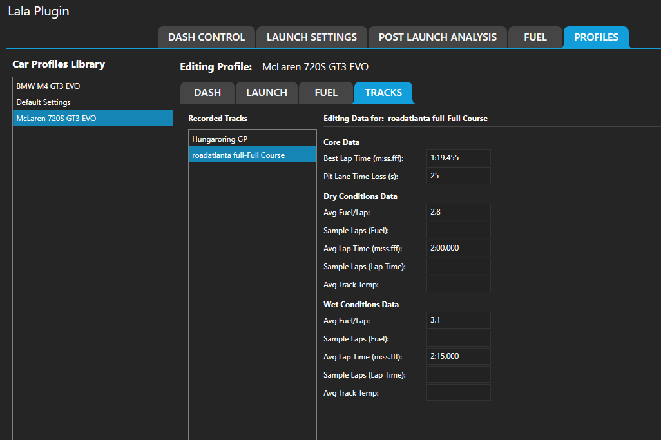

Slide 12
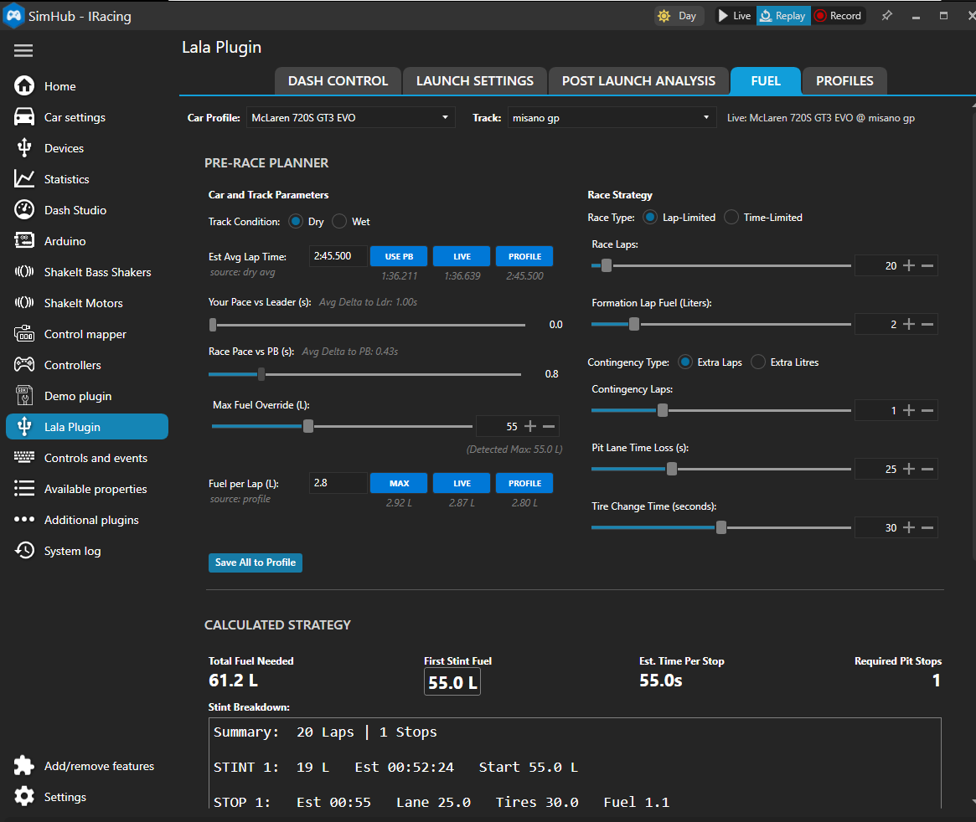

Slide 13
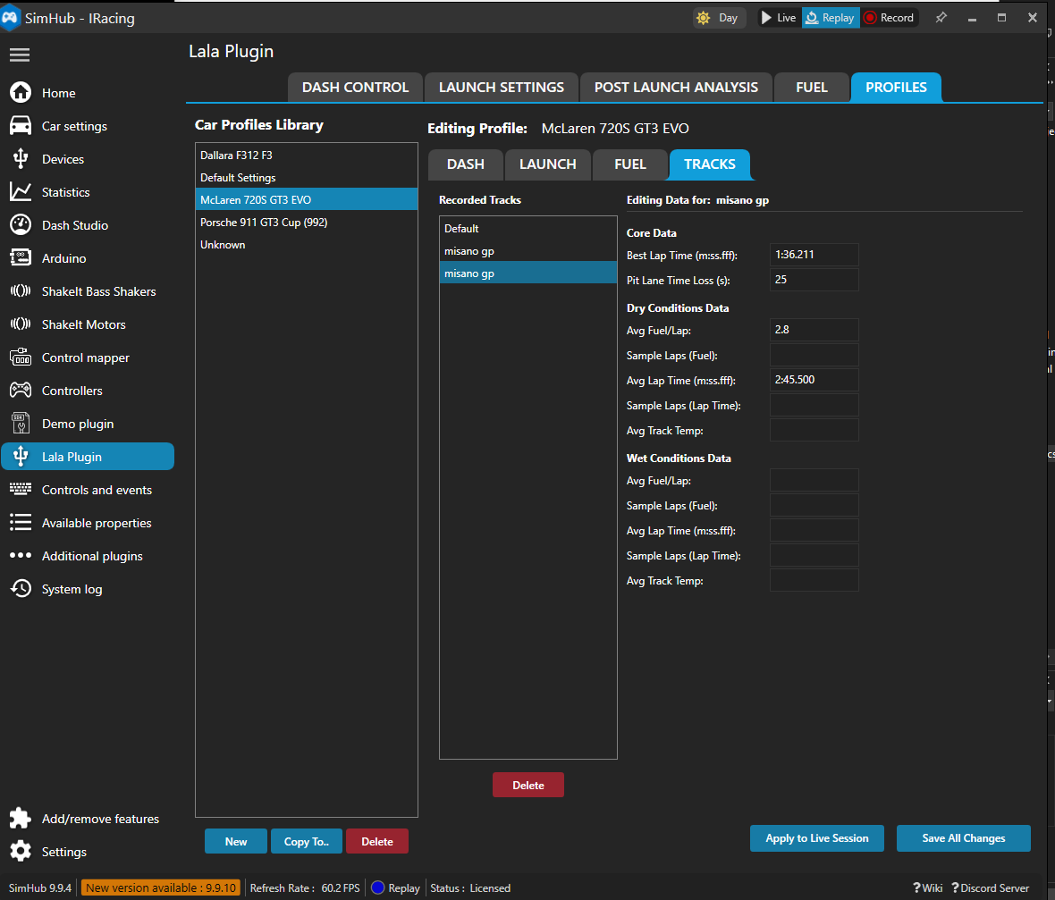

Slide 14
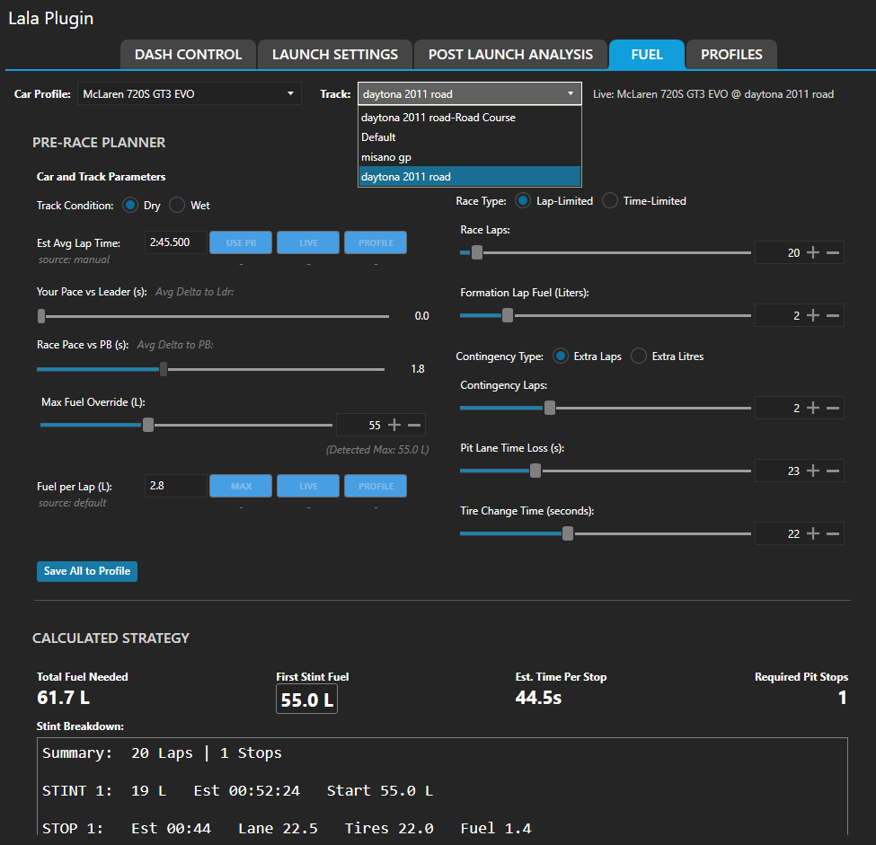

Slide 15
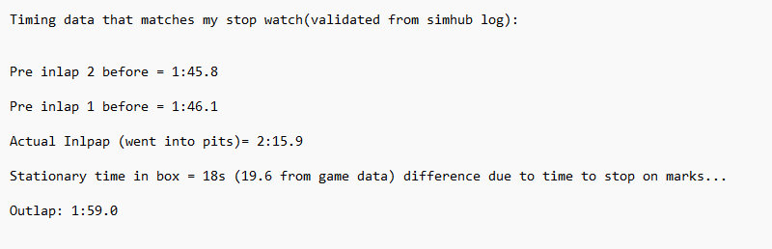

Slide 16
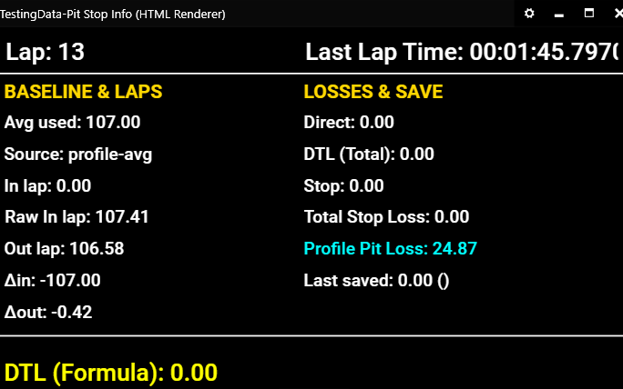
Start of Lap before Inlap – first S/F cross in replay

Slide 17
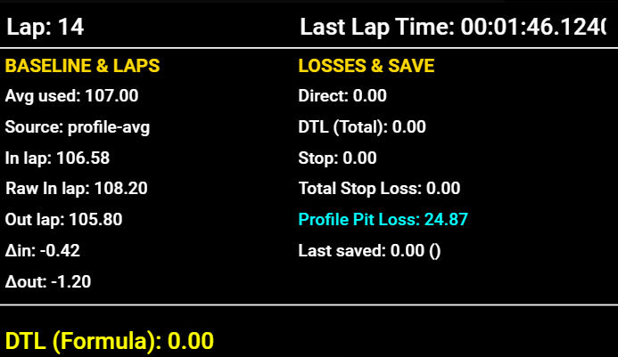
Start of Inlap (Just crossed S/F Line)

Slide 18
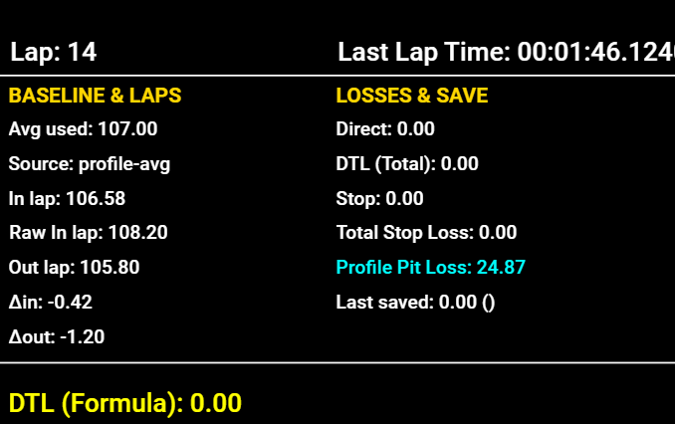
While Stationary in Pit Box

Slide 19
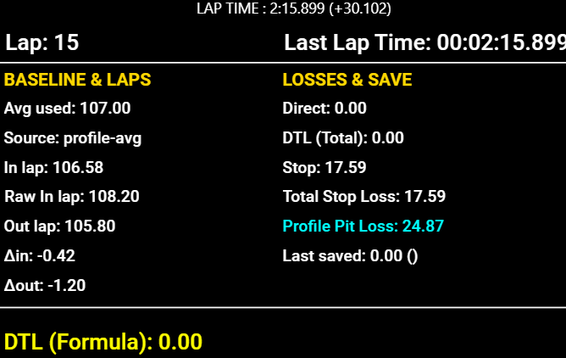
Start of OutLap just after S/F line

Slide 20
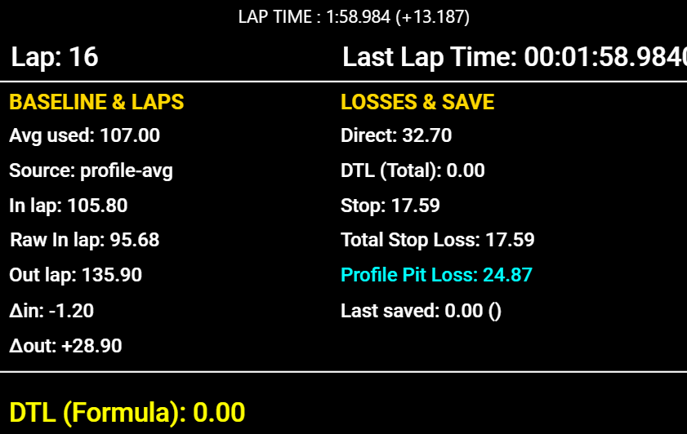
Start of Lap After Outlap (just after S/F line and outlap time known) – THIS IS WHEN WE WANT THE DATA CAPTURED AND FROZEN UNTIL NEXT EVENT

Slide 21
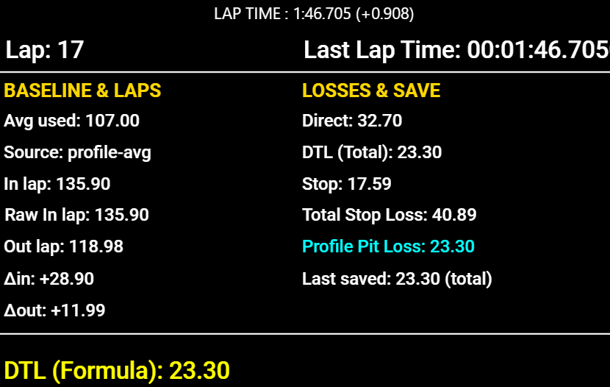
2 Laps After OutLap (just after S/F line) – 1st normal lap after pitting.

Slide 22
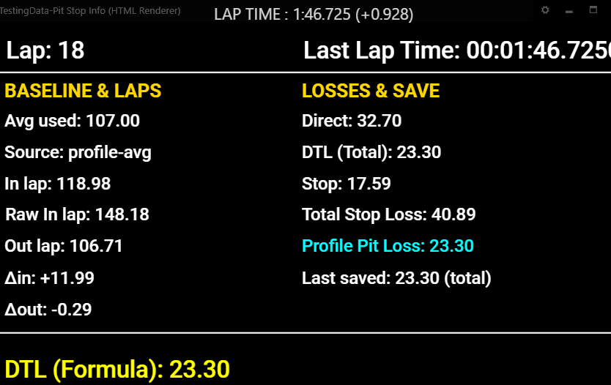
3 Laps After OutLap (just after S/F line) – 2st normal lap after pitting.

Slide 23
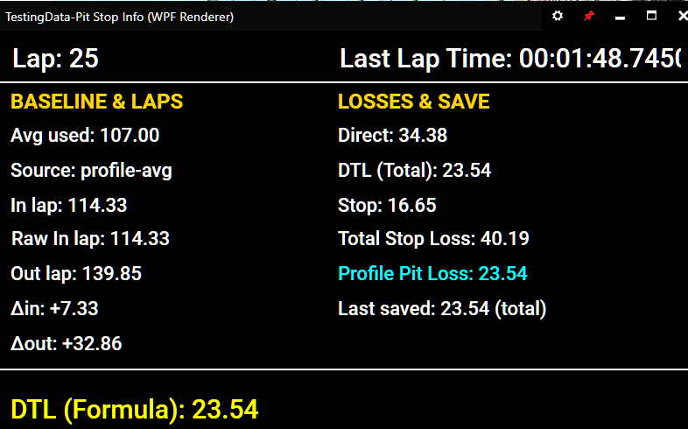
Lap After Outlap (just after S/F line) – Pit Box after S/F

Slide 24
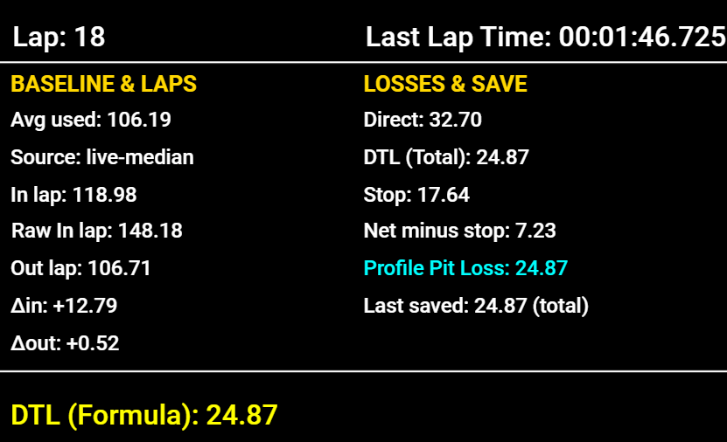
Pit Box BEFORE S/F
Pit Box AFTER S/F

Slide 25
Old property (still supported) | New canonical (use this going forward) | Notes
LalaLaunch.Lala.Pit.AvgPaceUsedSec | LalaLaunch.Pit.AvgPaceUsedSec | Seconds
LalaLaunch.Lala.Pit.AvgPaceSource | LalaLaunch.Pit.AvgPaceSource | "profile-avg", "live-median", "session-pb", etc.
LalaLaunch.Lala.Pit.InLapSec | LalaLaunch.Pit.InLapSec | Published at S/F when pit-lap completes
LalaLaunch.Lala.Pit.OutLapSec | LalaLaunch.Pit.OutLapSec | Published at S/F when out-lap completes
LalaLaunch.Lala.Pit.DeltaInSec | LalaLaunch.Pit.DeltaInSec | InLap − Avg
LalaLaunch.Lala.Pit.DeltaOutSec | LalaLaunch.Pit.DeltaOutSec | OutLap − Avg
LalaLaunch.Lala.Pit.DirectTravelSec | LalaLaunch.Pit.DirectTravelSec | Entry→Exit while rolling
LalaLaunch.Lala.Pit.StopSeconds | LalaLaunch.Pit.StopSeconds | Stationary box time
LalaLaunch.Lala.Pit.DriveThroughLossSec | LalaLaunch.Pit.DriveThroughLossSec | DTL saved to profile
LalaLaunch.Lala.Pit.ServiceStopLossSec | LalaLaunch.Pit.ServiceStopLossSec | DTL + Stop (gap estimate)
LalaLaunch.Lala.Pit.Profile.PitLaneLossSec | LalaLaunch.Pit.Profile.PitLaneLossSec | From profile JSON
LalaLaunch.Lala.Pit.LastSavedValueSec | LalaLaunch.Pit.LastSavedValueSec | Latest persisted value
LalaLaunch.Lala.Pit.LastSavedSource | LalaLaunch.Pit.LastSavedSource | "total" or "direct"
LalaLaunch.Lala.Pit.CandidateSavedSec | LalaLaunch.Pit.CandidateSavedSec | When we introduce candidate-apply
LalaLaunch.Lala.Pit.CandidateSource | LalaLaunch.Pit.CandidateSource | 〃
LalaLaunch.Lala.Pit.FormulaTopSec | LalaLaunch.Pit.FormulaTopSec | PitLap − Stop + OutLap
LalaLaunch.Lala.Pit.Phase | LalaLaunch.Pit.Phase | `idle
LalaLaunch.Lala.Pit.PanelVisible | LalaLaunch.Pit.PanelVisible | Optional; you said not needed
LalaLaunch.Lala.Pit.NetMinusStopSec | Deprecated → use LalaLaunch.Pit.ServiceStopLossSec | We removed this

